Slide 1


Scikit-Learn (sklearn)
Machine Learning in Python Made Easy
Dated: 14 June 2025
Instructor : Fawad Bahadur
Github: bahadurCorvit

Slide 2

Agenda
01
Introduction
05
Evaluate models with proper metrics
02
Learn end-to-end ML pipeline
06
Use pipelines and cross-validation
03
Implement classification, regression, clustering
07
Tune models with GridSearchCV
04
Apply preprocessing techniques
08
Complete a mini ML project

Slide 3


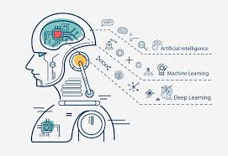




What is Scikit-Learn?
Scikit-Learn (sklearn) is an open-source Python library for:
🔬 Machine Learning
📊 Data Mining
🧠 Data Analysis
Built on:
NumPy
SciPy
Matplotlib
Key Features:
Easy-to-use API
Wide range of ML algorithms
Integration with other tools (Pandas, NumPy)

Slide 4




Why Use Scikit-Learn?
Advantages of Scikit-Learn:
Simple and consistent API for all ML tasks
Interoperable with other Python libraries (Pandas, NumPy)
Efficient implementation of many ML algorithms
Extensive documentation and community support
Built-in tools for model evaluation and selection
Ideal for:
Beginners & advanced users
Prototyping ML models quickly

Slide 5
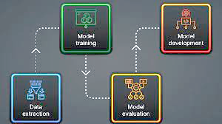
Scikit-Learn Workflow
Typical ML Pipeline in Scikit-Learn:
Import Libraries
Load Dataset
Preprocess Data
Split Data (Train/Test)
Choose a Model
Train the Model
Make Predictions
Evaluate Performance
Optional: Hyperparameter Tuning & Cross-Validation

Slide 6


Installation
Requirements:
Python ≥ 3.8
NumPy, SciPy (automatically installed)
Using pip:
pip install scikit-learn
Using conda:
conda install scikit-learn
Check installation:
import sklearn
print(sklearn.__version__)

Slide 7

Importing Scikit-Learn
Typical Imports in scikit-learn
import numpy as np
import pandas as pd
from sklearn.model_selection import train_test_split
from sklearn.linear_model import LinearRegression
from sklearn.metrics import mean_squared_error
Easy to integrate with:
NumPy for numerical operations
Pandas for data manipulation
Matplotlib/Seaborn for visualization

Slide 8


Built-in Datasets
Scikit-Learn Provides Sample Datasets
from sklearn.datasets import load_iris
data = load_iris()
print(data.feature_names)
Popular Built-in Datasets:
load_iris() – flower classification
load_digits() – handwritten digits
load_diabetes() – regression task
load_breast_cancer() – binary classification

Slide 9
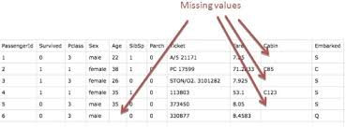
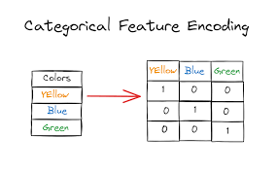
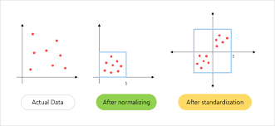
Data Preprocessing in Scikit-Learn
Why Preprocess?
To ensure data is clean, consistent, and suitable for training.
Common Preprocessing Tasks:
Handling missing values
Encoding categorical features
Feature scaling/normalization
Key Modules:
from sklearn.preprocessing import StandardScaler, LabelEncoder
from sklearn.impute import SimpleImputer

Slide 10
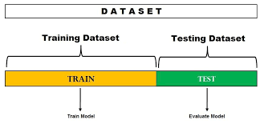
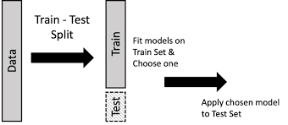
Train-Test Split
Why Split Data?
To evaluate the model's performance on unseen data.
Function Used:
from sklearn.model_selection import train_test_split
X_train, X_test, y_train, y_test = train_test_split(
X, y, test_size=0.2, random_state=42)
Parameters:
test_size: Proportion of test data (e.g., 0.2 = 20%)
random_state: Ensures reproducibility
Goal:
Prevent overfitting by using separate test data

Slide 11
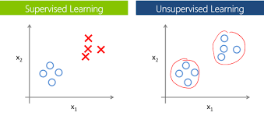
Supervised vs Unsupervised Learning
Two Main Types in Scikit-Learn
🎓 Supervised Learning:
Learn from labeled data
🔍 Unsupervised Learning:
Discover hidden patterns
Type | Description | Examples
Supervised | Input and labeled output | Classification, Regression
Unsupervised | Only input data, no labels | Clustering, Dimensionality Reduction

Slide 12
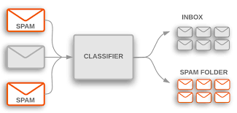
Supervised Learning – Classification
What is Classification?
Predicting a discrete label or category.
Popular Classification Models in Scikit-Learn:
LogisticRegression
KNeighborsClassifier
DecisionTreeClassifier
RandomForestClassifier
SVC (Support Vector Classifier)
NaiveBayes (GaussianNB)
Example Use Cases
Email spam detection
Disease diagnosis
Image recognition

Slide 13
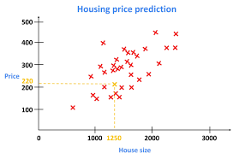
Supervised Learning – Regression
What is Regression?
Predicting a continuous numerical value.
Popular Regression Models in Scikit-Learn:
LinearRegression
Ridge, Lasso
SVR (Support Vector Regression)
DecisionTreeRegressor
RandomForestRegressor
Example Use Cases
House price prediction
Stock price forecasting
Sales estimation

Slide 14
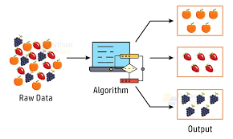
Unsupervised Learning – Clustering
What is Clustering?
Grouping similar data points without labels.
Popular Clustering Algorithms in Scikit-Learn:
KMeans
DBSCAN
AgglomerativeClustering
Example Use Cases
Customer segmentation
Social network analysis
Market basket analysis

Slide 15
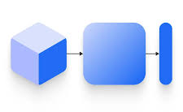
Unsupervised Learning – Dimensionality Reduction
What is Dimensionality Reduction?
Reducing the number of input features while preserving important information.
Popular Techniques in Scikit-Learn:
PCA (Principal Component Analysis)
TruncatedSVD
t-SNE (for visualization)
Example Use Cases
Visualizing high-dimensional data
Speeding up ML models
Removing multicollinearity
Fewer dimensions → Faster training + Less overfitting

Slide 16
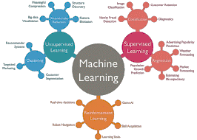
Model Selection in Scikit-Learn
Choosing the Right Model
Depends on:
Type of problem (classification, regression, clustering)
Size and nature of dataset
Performance goals (accuracy, speed, interpretability)
Scikit-Learn Helps With:
Wide variety of models
Easy model switching
Same interface: .fit(), .predict()
Try multiple models & compare performance!

Slide 17
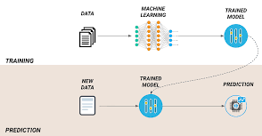
Training a Model
Basic Steps to Train a Model
from sklearn.linear_model import LinearRegression
model = LinearRegression()
model.fit(X_train, y_train)
What Happens During .fit()?
Learns the relationship between input X_train and output y_train
Stores model parameters (like weights)
All models in sklearn follow:
model.fit(X_train, y_train)
predictions = model.predict(X_test)

Slide 18
Making Predictions
Once Trained, Use the Model to Predict
y_pred = model.predict(X_test)
What Happens?
The model uses learned parameters
Applies them to unseen X_test data
Returns predicted values (y_pred)
Used for:
Evaluating performance
Making real-world decisions
✅ Works the same way for classification & regression

Slide 19
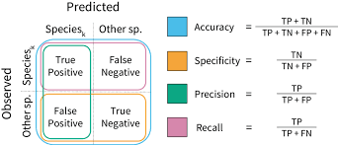
Model Evaluation – Classification Metrics
How Well Did the Model Perform?
Key Classification Metrics:
Accuracy – Correct predictions / Total predictions
Precision – True Positives / (True Positives + False Positives)
Recall – True Positives / (True Positives + False Negatives)
F1 Score – Harmonic mean of precision and recall
Confusion Matrix – Visual performance breakdown
Scikit-Learn Tools:
from sklearn.metrics import accuracy_score, precision_score, recall_score, f1_score, confusion_matrix

Slide 20
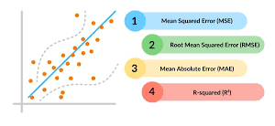
Model Evaluation – Regression Metrics
Evaluate Regression Models Using These Metrics:
Mean Absolute Error (MAE)
Average of absolute differences between predicted and actual values
Mean Squared Error (MSE)
Average of squared differences
Root Mean Squared Error (RMSE)
Square root of MSE
R² Score (Coefficient of Determination)
Proportion of variance explained by the model
Scikit-Learn Example:
from sklearn.metrics import mean_squared_error, r2_score

Slide 21
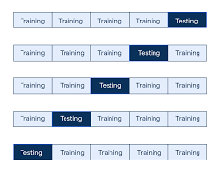
Cross-Validation
What is Cross-Validation?
A technique to evaluate model performance more reliably by splitting data into multiple train-test folds.
Scikit-Learn Function:
from sklearn.model_selection import cross_val_score
scores = cross_val_score(model, X, y, cv=5)
Benefits:
Reduces overfitting risk
Gives a better estimate of generalization
Works with any supervised model
cv=5 means 5-fold cross-validation

Slide 22
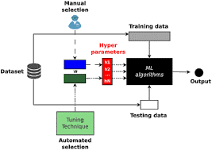
Hyperparameter Tuning
What Are Hyperparameters?
Settings passed before training (e.g., number of neighbors in KNN)
📌 Not learned during training, but significantly impact model performance.
📦 Tuning Methods in Scikit-Learn:
GridSearchCV – Exhaustive search
RandomizedSearchCV – Random combinations
from sklearn.model_selection import GridSearchCV
grid = GridSearchCV(model, param_grid, cv=5)
grid.fit(X_train, y_train)
Find the best combination of parameters

Slide 23
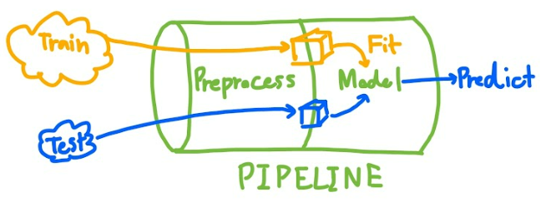
Pipelines in Scikit-Learn
Why Use Pipelines?
Combine multiple steps (e.g., preprocessing + modeling) into a single object.
from sklearn.pipeline import Pipeline
from sklearn.preprocessing import StandardScaler
from sklearn.linear_model import LogisticRegression
pipe = Pipeline([
('scaler', StandardScaler()),
('classifier', LogisticRegression())
])
pipe.fit(X_train, y_train)
✅ Benefits:
Clean code
Reproducibility
Reduces data leakage

Slide 24
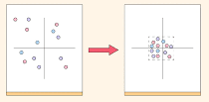
Feature Scaling
Why Scale Features?
Some ML algorithms are sensitive to feature scales (e.g., KNN, SVM, Gradient Descent-based models)
📦 Common Scalers in Scikit-Learn:
StandardScaler: Mean = 0, Std = 1
MinMaxScaler: Scales between 0 and 1
RobustScaler: Handles outliers well
from sklearn.preprocessing import StandardScaler
scaler = StandardScaler()
X_scaled = scaler.fit_transform(X)
⚠️ Always fit scaler only on training data!

Slide 25
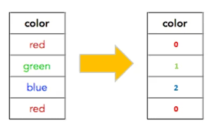
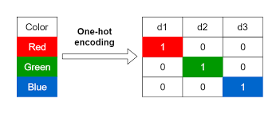
Handling Categorical Data
🔡 Why Handle Categorical Features?
ML models work with numbers, not strings.
📦 Techniques in Scikit-Learn:
LabelEncoder: Converts labels to numbers
OneHotEncoder: Creates binary columns for each category
from sklearn.preprocessing import OneHotEncoder
encoder = OneHotEncoder()
X_encoded = encoder.fit_transform(X_categorical)
🧠 Use ColumnTransformer to apply encoders selectively in pipelines.

Slide 26
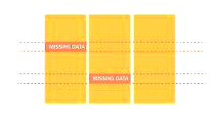
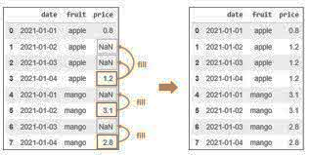
Handling Missing Data
🚫 Why Handle Missing Values?
Missing values can break model training or reduce accuracy.
📦 Scikit-Learn Solution: SimpleImputer
from sklearn.impute import SimpleImputer
imputer = SimpleImputer(strategy='mean') # or 'median', 'most_frequent'
X_imputed = imputer.fit_transform(X)
🧠 Strategies:
Mean/Median for numerical data
Most frequent for categorical data
Constant value (e.g., 0 or “Unknown”)
🔄 Use in Pipelines for automation!

Slide 27


Saving and Loading Models
💾 Preserve Trained Models for Later Use
📦 Using joblib (preferred for sklearn objects):
import joblib
# Save model
joblib.dump(model, 'model.pkl')
# Load model
model = joblib.load('model.pkl’)
✅ Useful for:
Reuse without retraining
Deployment in production systems
Sharing models with others

Slide 28

Real-World Project Example
📊 Use Case: Predicting House Prices
Steps:
Load dataset (e.g., Boston Housing)
Preprocess features (scale, handle missing)
Split into train/test sets
Train LinearRegression model
Evaluate using MSE & R²
Tune hyperparameters (if needed)
Save final model
🧠 Combines: Regression, Preprocessing, Pipeline, Evaluation
📦 Encourages end-to-end ML workflow using Scikit-Learn

Slide 29


Integration with Other Libraries
🔗 Scikit-Learn Works Seamlessly With:
📦 NumPy – Numerical arrays
📊 Pandas – DataFrames for structured data
📉 Matplotlib / Seaborn – Visualization
🔍 XGBoost, LightGBM – Advanced models using sklearn API
🧠 TensorFlow / PyTorch – Deep learning + sklearn for preprocessing
📦 Many tools are Scikit-Learn compatible via .fit() / .transform() API
🤝 Scikit-Learn = Core of the Python ML ecosystem

Slide 30


Common Challenges & Best Practices
⚠️ Common Pitfalls:
Not scaling data when needed
Data leakage (using test data in training)
Overfitting from too complex models
Ignoring class imbalance
✅ Best Practices:
Use Pipelines to prevent leakage
Apply Cross-Validation for reliable metrics
Tune hyperparameters systematically
Monitor overfitting with validation set
Document & version control your models

Slide 31


Summary and Final Thoughts
📌 Key Takeaways:
Scikit-Learn is a powerful, easy-to-use ML library in Python
Supports full ML pipeline: preprocessing → modeling → evaluation → deployment
Offers a wide range of algorithms for both supervised and unsupervised learning
Encourages best practices via pipelines, cross-validation, and grid search
Integrates well with tools like Pandas, NumPy, Matplotlib, and joblib
🎯 Next Steps:
Explore real datasets
Try out various models
Build and deploy your own ML project!

Slide 32
THANK YOU

